Slide 1
Self-attention

Slide 2

Attention is all you need
https://arxiv.org/abs/1706.03762

Slide 3

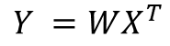
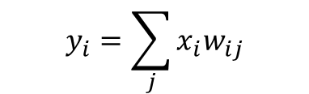
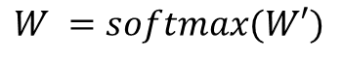
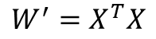

Self attention
y1
y2
y3
y4
y5
y6
y7
y8
$$y_{i}=\sum_{j}{{x_{i}w}_{ij}}$$
Self attention
$$w_{ij}^{′}=x_{i}^{T}x_{j}$$
$$w_{ij}^{ }=softmax(w_{ij}^{′})$$
$$W^{′}=X^{T}X$$
$$W^{ }=softmax(W′)$$
X - (b,t,k)
b – batch size
t – sequence length
k – embedding dim
$$Y^{ }=WX^{T}$$
x1
x2
x3
x4
x5
x6
x7
x8

Slide 4
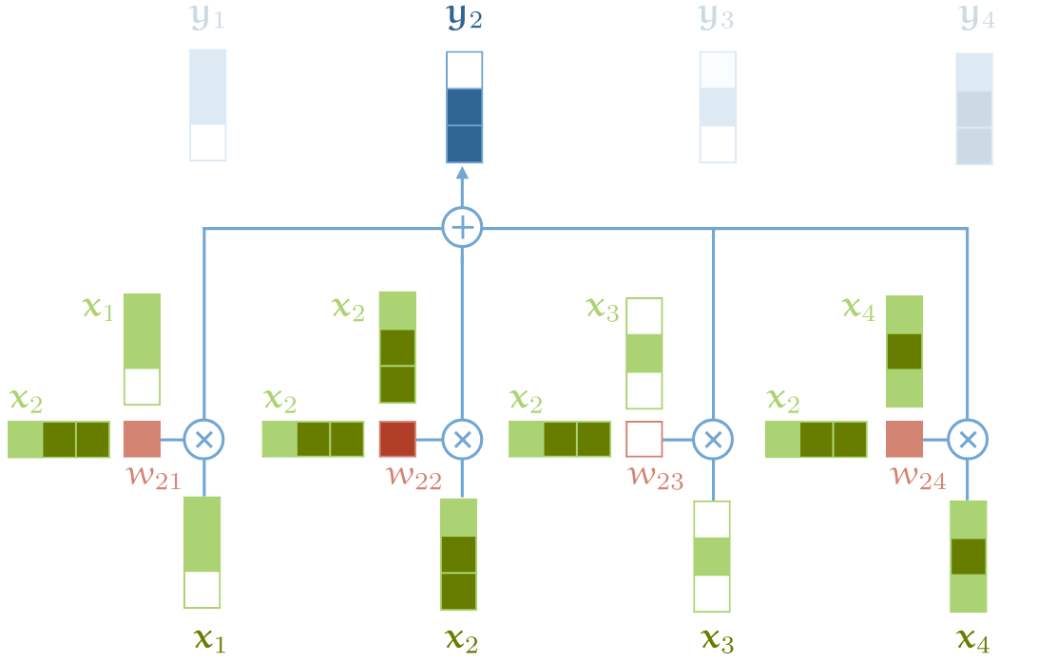
Self attention

Slide 5
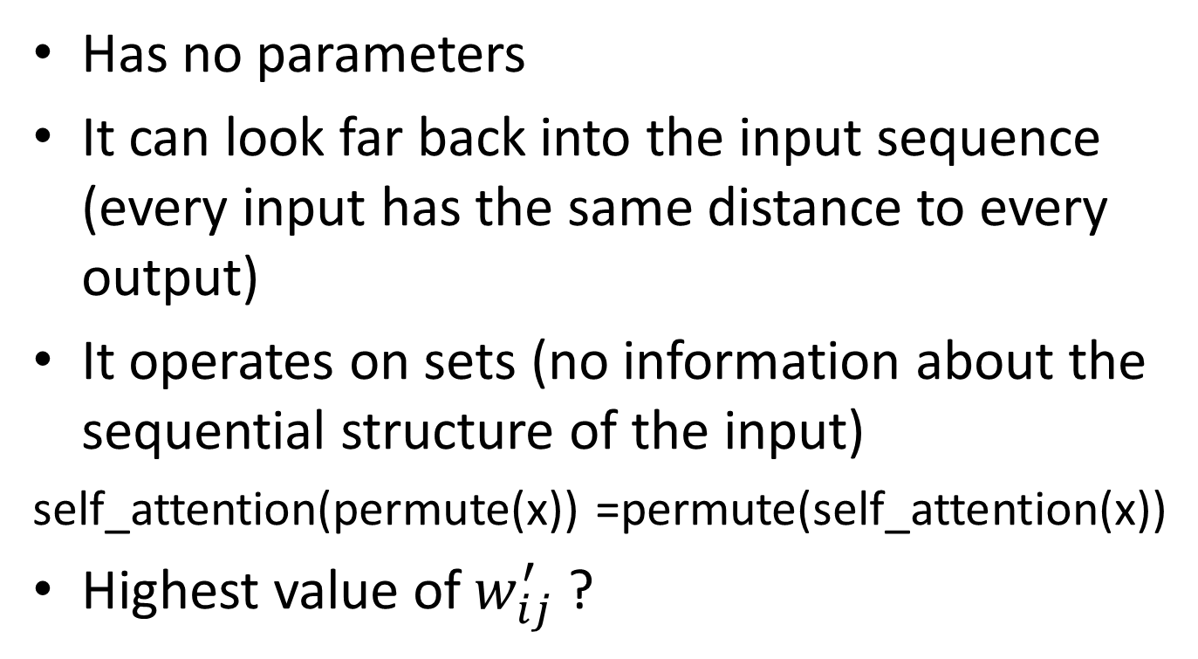
Self attention
Has no parameters
It can look far back into the input sequence (every input has the same distance to every output)
It operates on sets (no information about the sequential structure of the input)
self_attention(permute(x)) =permute(self_attention(x))
Highest value of $w_{ij}^{′}$ ?

Slide 6
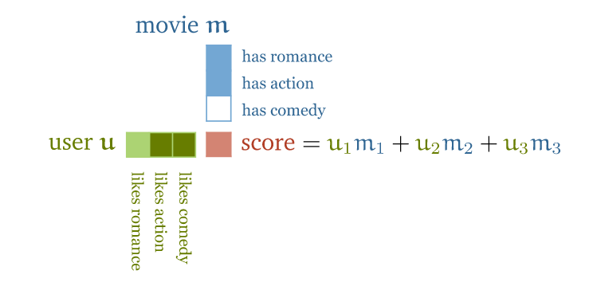
Self attention
http://peterbloem.nl/blog/transformers

Slide 7
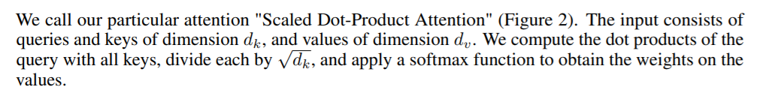
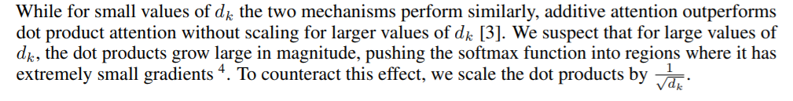
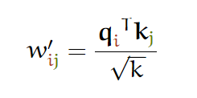
Scaled Dot-Product Attention
k(d_{k} in the paper) – dimension of the embedding

Slide 8
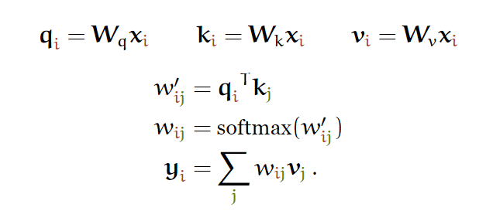
Attention: query, keys and values
“An attention function can be described as mapping a query and a set of key-value pairs to an output, where the query, keys, values, and output are all vectors.”

Slide 9
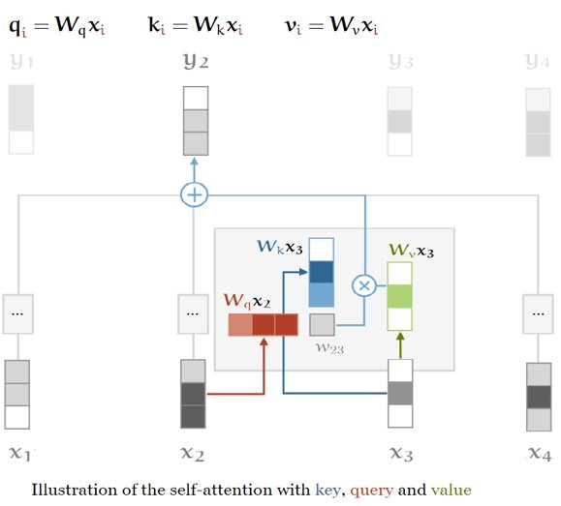
Key, query and values
To obtain the query, keys and values, there matrices are introduced: W_{q}, W_{k}, W_{v} (added some learnable parameters)

Slide 10
Key, query and values
key
query
value
Used in the weighted sum of the output

Slide 11
Key, query and values
key
query
value
When computing y_{i}, x_{i} is matched against every other input

Slide 12
Key, query and values
key
query
value
The vector that the query is matched against

Slide 13
Soft version of a dictionary
my_dict = {‘key1’: 24, ‘key2’: 1, ‘key3’: 6}
my_dict[key1] == 24
key
value
query

Slide 14
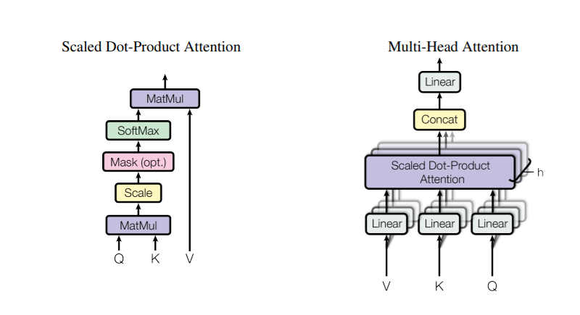
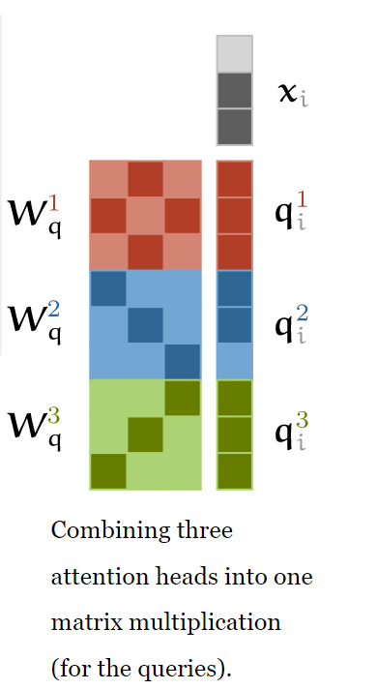
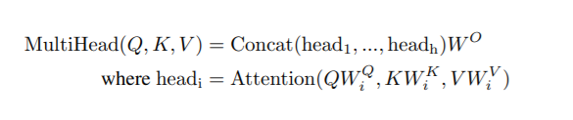
Multi-head attention

Slide 15
Multi-head attention
The words in a sentences relate to each other in different ways
The students were not too tired after the long lecture.
Multiple self attention heads applied in parallel – inefficient
Project the inputs by multiplying them with a matrix such that they have a lower dimensionality

Slide 16
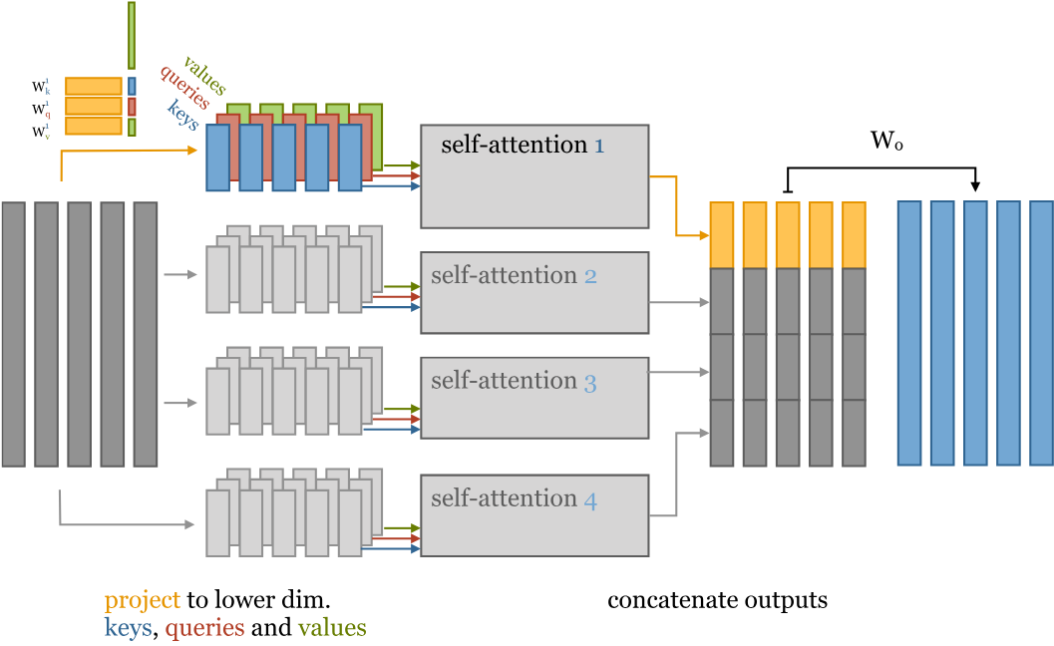
Multi-head attention
Each head receives low-dimensional keys queries and values (for the key, queries and values)
https://peterbloem.nl/blog/transformers

Slide 17
Multi-head attention
h – number of attention heads
k – dimensionality of the input
This requires 3h matrices of size k by k/h. In total, this gives us 3h∙k∙k/h=3k² parameters to compute the inputs to the multi-head self-attention
The same as we had for the single-head self-attention

Slide 18
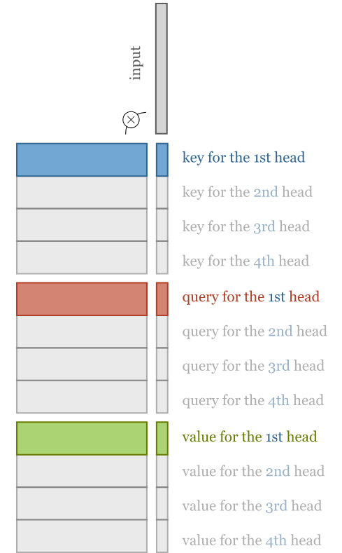
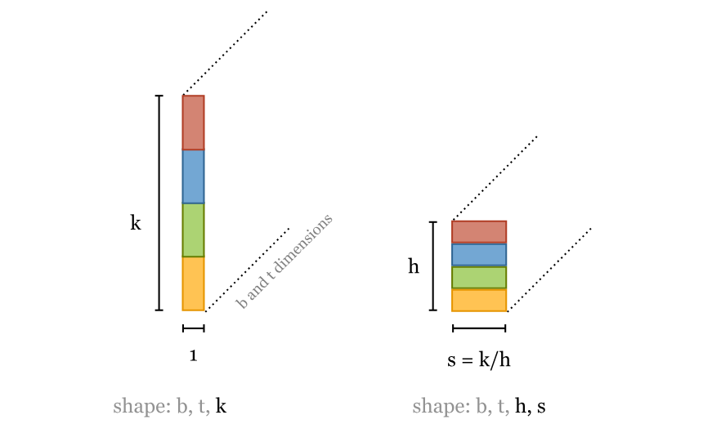
Multi-head attention Alternative implementation
We can even implement this with just three k×k matrix multiplications as in the single-head self-attention. The only extra operation we need is to slice the resulting sequence of vectors into chunks.

Slide 19
Implementation of self-attention
https://github.com/pbloem/former/tree/master/former

Slide 20
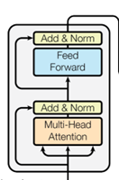
Transformer: encoder block
Multi head attention layer
Layer normalization
Feed forward layer (applied independently to each vector)
Layer normalization
+ Residual connections (before the normalizations)

Slide 21
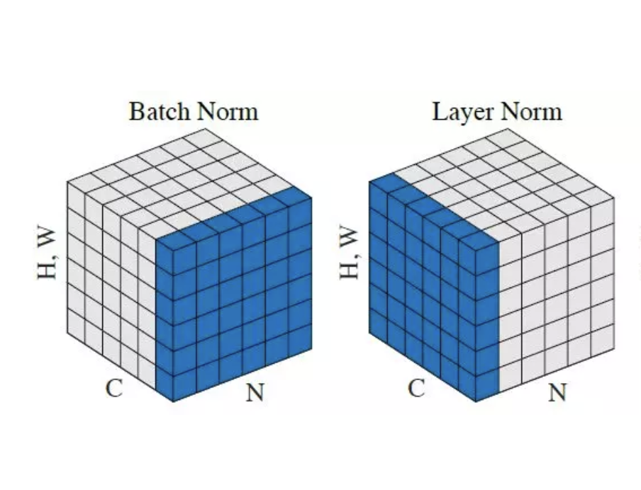
Batch norm vs Layer norm

Slide 22
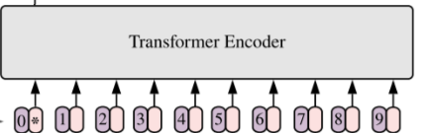
Lack of sequential information
Position embeddings
Assign a embedding vector to every position in our sequence
Sum the embedding vector of each word with the corresponding position embedding
The drawback is that we have to see sequences of every length during training, otherwise the relevant position embeddings don't get trained

Slide 23
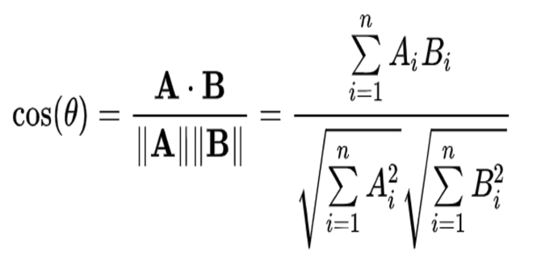
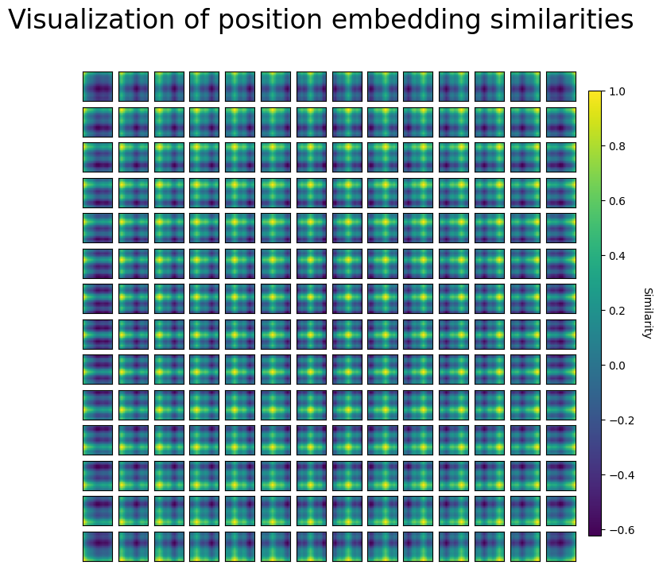
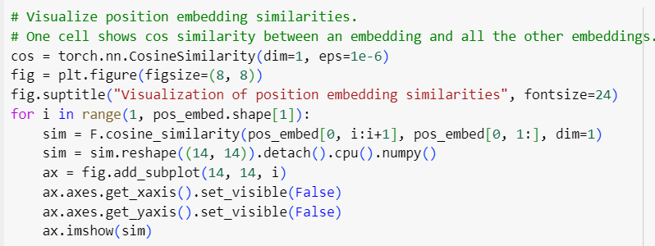
The position embedding vectors learn distance within the image thus neighboring ones have high similarity.
In the example:
Split the image into 14x14 patches
Token size: 768
Pos embedding size: 1, 197, 768

Slide 24
Lack of sequential information
Position encodings
Assign a embedding vector to every position in our sequence
Sum the embedding vector of each word with the corresponding position embedding
The drawback is that we have to see sequences of every length during training, otherwise the relevant position embeddings don't get trained

Slide 25
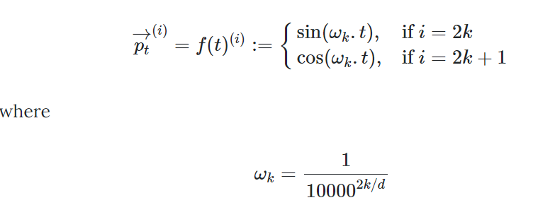
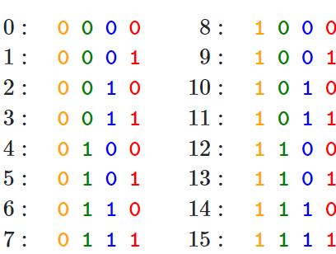
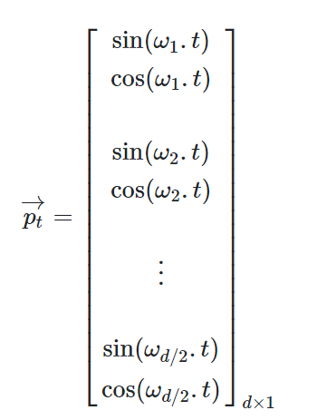
Position encodings
The frequencies are decreasing along the vector dimension

Slide 26
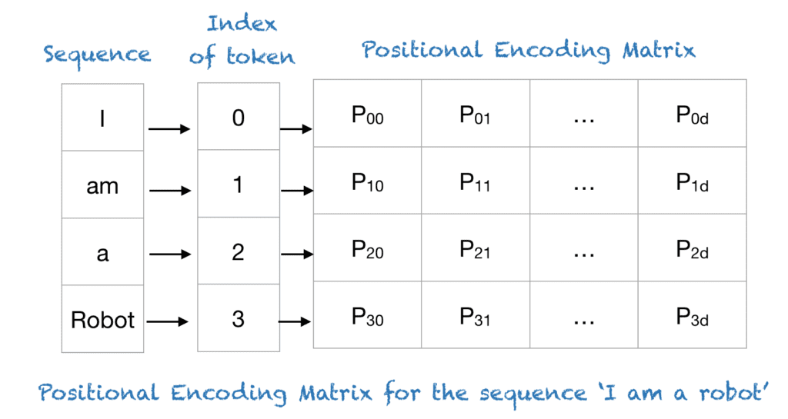
Lack of sequential information
Position encodings
choose some function f:ℕ→ℝ^{d} to map the positions to real valued vectors, and let the network figure out how to interpret these encodings.
d : Dimension of the output embedding space
https://machinelearningmastery.com/a-gentle-introduction-to-positional-encoding-in-transformer-models-part-1/

Slide 27
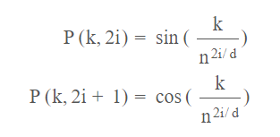
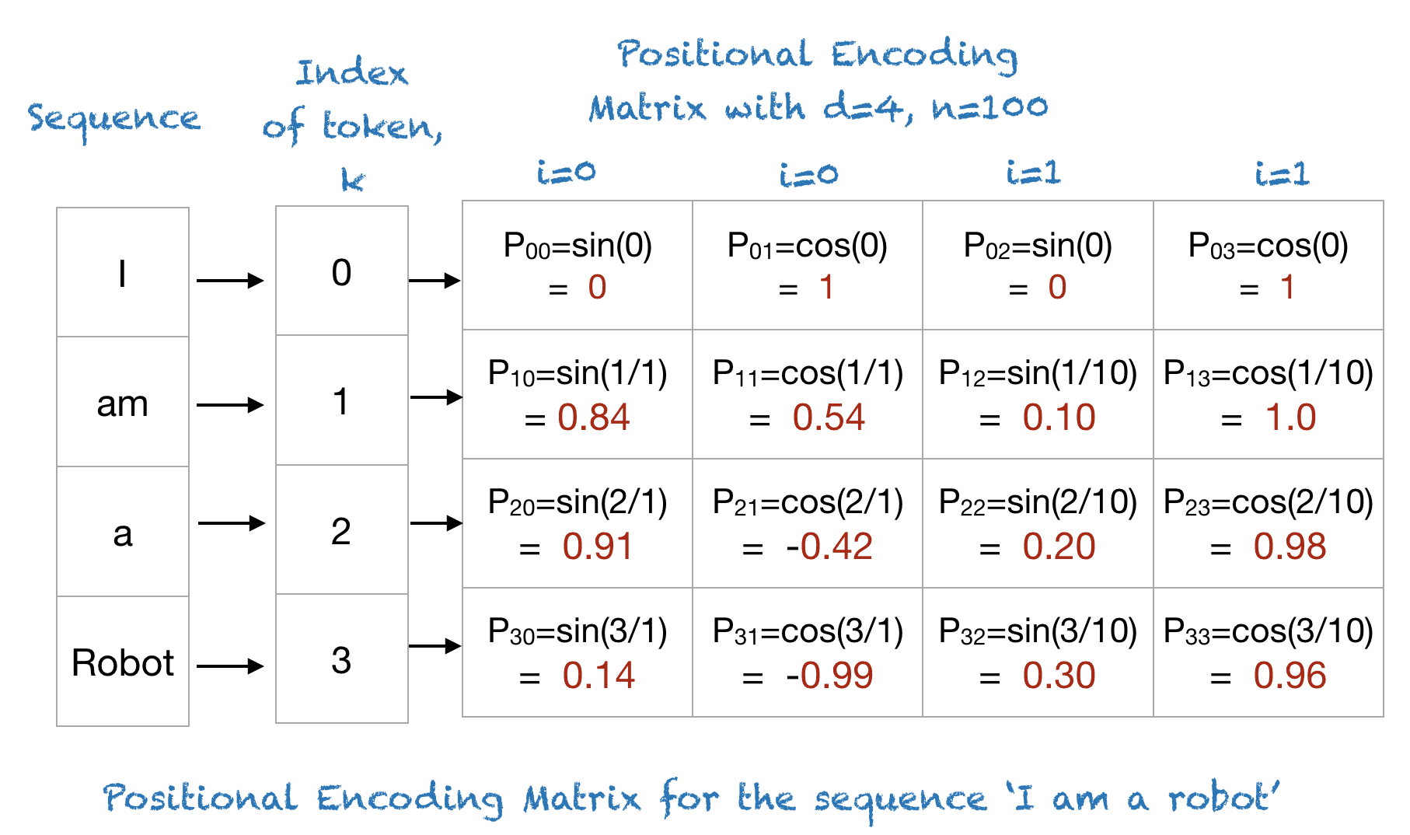
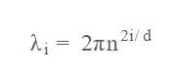
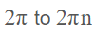
Position encodings
n : User-defined scalar, set to n= 100 in this example, but in the original paper n = 10000
i – used to map column indices, 0 <= i < d/2, a single value of i maps both sine and cosine

Slide 28
Position encodings
The sine and cosine functions have values in [-1, 1], which keeps the values of the positional encoding matrix in a normalized range.
As the sinusoid for each position is different, you have a unique way of encoding each position.
You have a way of measuring or quantifying the similarity between different positions, hence enabling you to encode the relative positions of words.

Slide 29
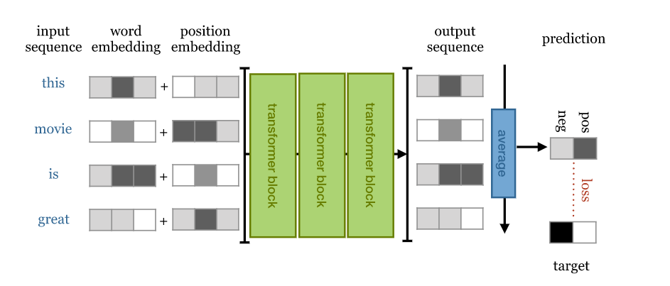
Simple transformer for sentiment analysis

Slide 30
Attention is all you need

Slide 31
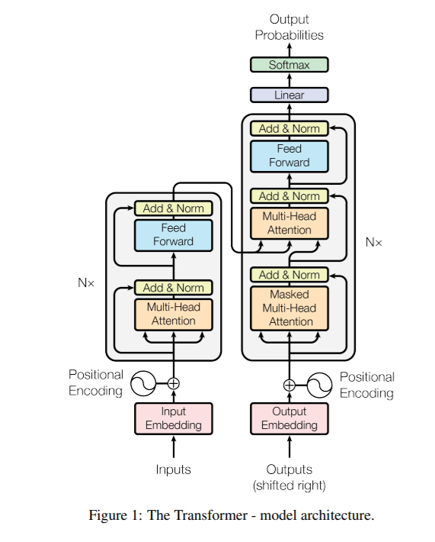
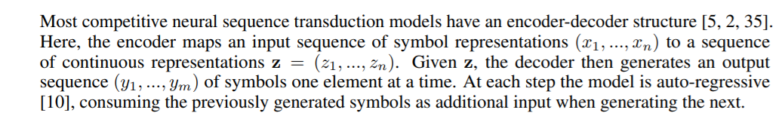
Transformer architecture

Slide 32
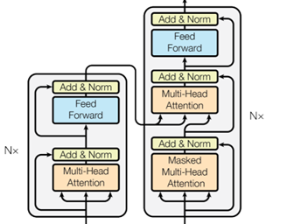
Transformer: decoder block
Input: block on the same level in the encoder and the previous level in the decoder
Masked multi head attention

Slide 33

BERT
Bidirectional Encoder Representations from Transformers
https://arxiv.org/abs/1810.04805

Slide 34
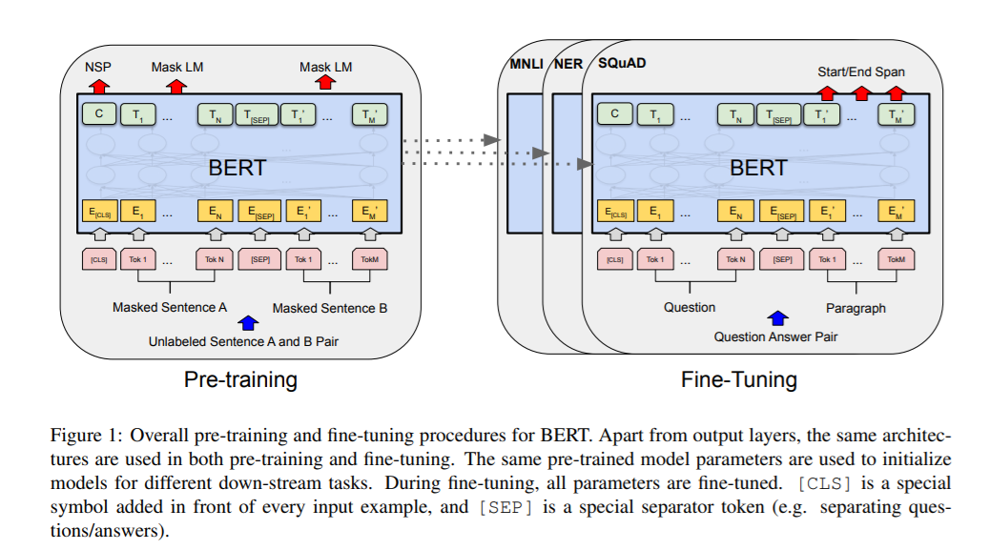
BERT
https://jalammar.github.io/a-visual-guide-to-using-bert-for-the-first-time/

Slide 35
BERT
PRE-TRAINED on a large general-domain corpus consisting of 800M words from English books 2.5B words of text from English Wikipedia articles.
Masking: words are masked out, replaced with a random word or kept as they are. The model is then asked to predict, for only these words, what the original words were.

Slide 36
BERT
PRETRAINING
Masking
Next Sentence Prediction: Two sequences of about 256 words are sampled that either (a) follow each other directly in the corpus, or (b) are both taken from random places. The model must then predict whether a or b is the case.

Slide 37
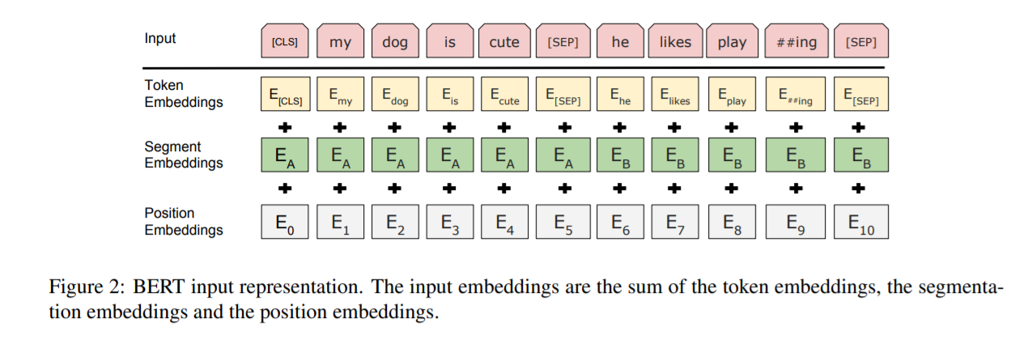
BERT
Input is prepended with a special <CLS> token. The output vector corresponding to this token is used as a sentence representation in sequence classification tasks like the next sentence classification.

Slide 38
BERT
FINE-TUNING
a single task-specific layer is placed after the transformer blocks, which maps the general purpose representation to a task specific output.
Classification: maps the first output token (corresponding to <CLS>) to softmax probabilities over the classes
Training
2500 M words from Wikipedia
800M words from BookCorpus

Slide 39
GPT-2
Autoregressive language model, causal
Dimensions
48 blocks
Token dimension 768
12 attention heads
Sequence length: 1024
1.5B parameters
WebText dataset
40 GB of text
Weblinks from reddit, links with at least 3 karma

Slide 40
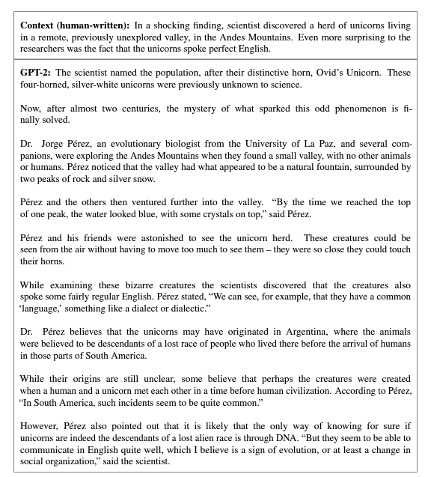

Slide 41
GPT-3
Autoregressive language model, causal
Dimensions
96 blocks
Token dimension 12288
96 attention heads
175B parameters
Sequence length: 2048
Lambdalabs estimated a hypothetical cost of around $4.6 million US dollars and 355 years to train GPT-3 on a single GPU in 2020.
Trained on 10K GPUs in around 12 days
Common Crawl dataset, WebText2 , Wikipedia

Slide 42
Other resources
Jay Alammar series on transformers
https://jalammar.github.io/
Let’s build GPT from scratch
https://www.youtube.com/watch?v=kCc8FmEb1nY
State of GPT
https://www.youtube.com/watch?v=bZQun8Y4L2A

Slide 43
An Image is Worth 16x16 Words: Transformers for Image Recognition at Scale
Vision transformer

Slide 44
Official implementation in JAX: https://github.com/google-research/vision_transformer#vision-transformer

Slide 45
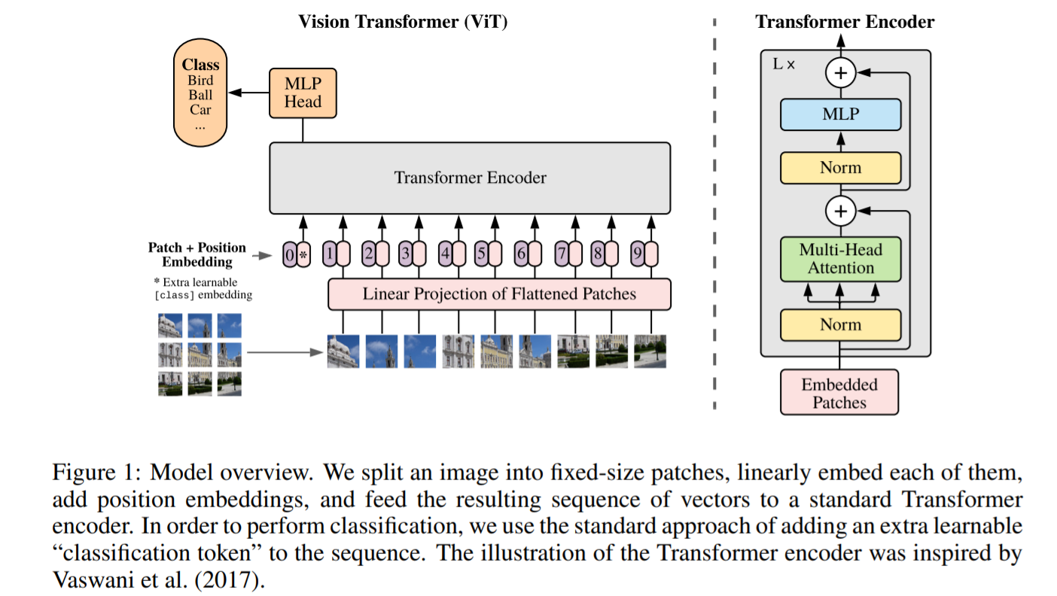
Vision transformer

Slide 46
Vision transformer
The image x ∈ R ^{H×W×C} is transformed into a sequence of flattened 2D patches x_{p} ∈ R^{N×(P2 ·C)}
(P, P) is the resolution of each image patch
sequence length: N = HW/P²
Flatten the patches and map to D dimensions with a trainable linear projection
constant latent vector size D through all of its layers

Slide 47
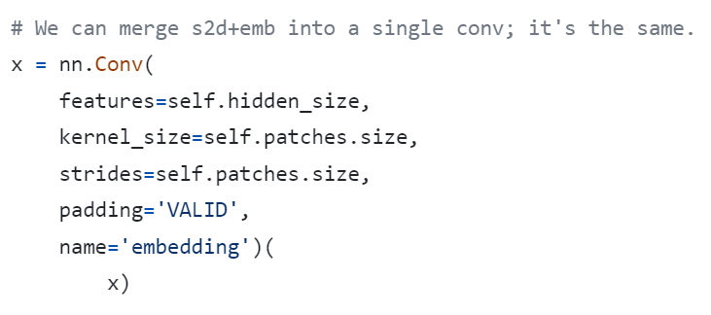
Vision transformer
https://github.com/google-research/vision_transformer/blob/main/vit_jax/models_vit.py

Slide 48
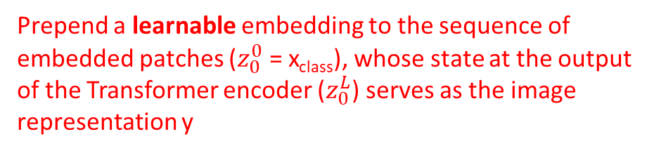
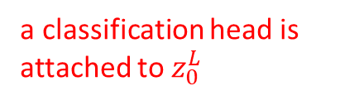
Vision transformer
a classification head is attached to $z_{0}^{L}$
Prepend a learnable embedding to the sequence of embedded patches ($z_{0}^{0}$ = x_{class}), whose state at the output of the Transformer encoder ($z_{0}^{L}$) serves as the image representation y

Slide 49
Vision transformer
0, 1, 2, …
Position embeddings are added to the patch embeddings to retain positional information.
(standard learnable 1D position embeddings)

Slide 50
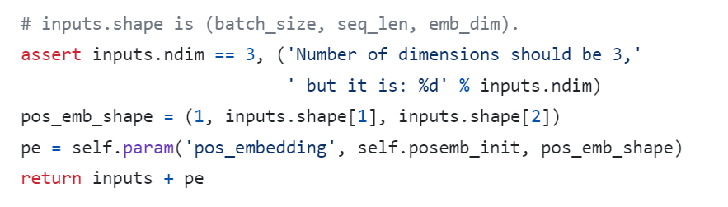
Vision transformer
https://github.com/google-research/vision_transformer/blob/main/vit_jax/models_vit.py

Slide 51
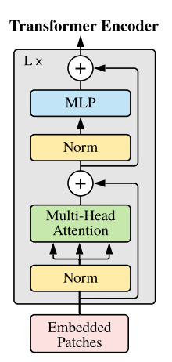
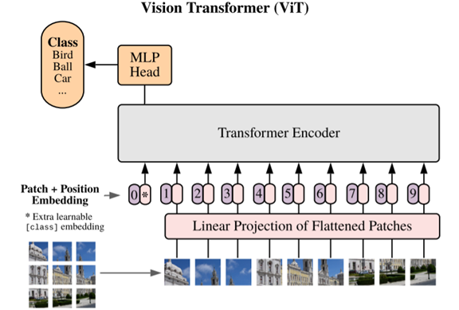
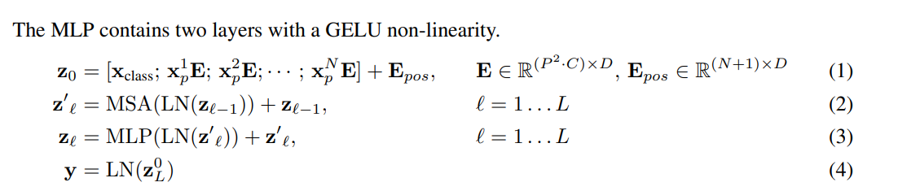
Vision Transformer
The Transformer encoder consists of alternating layers of multiheaded self-attention and MLP blocks.

Slide 52
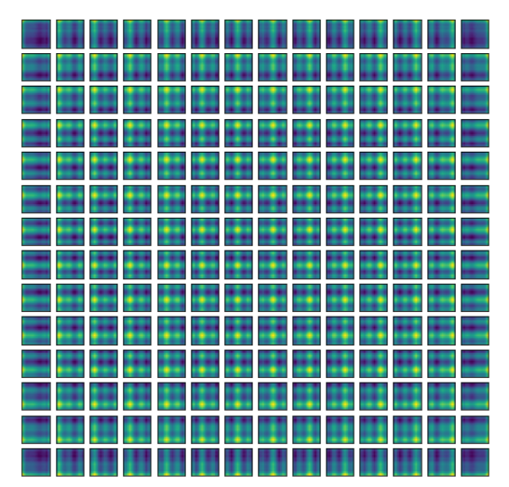
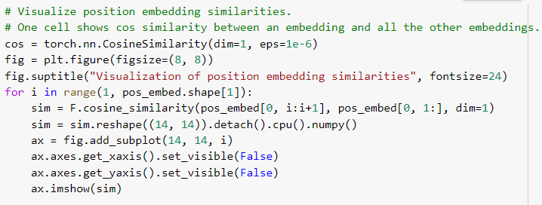
Position Embeddings Visualisation

Slide 53
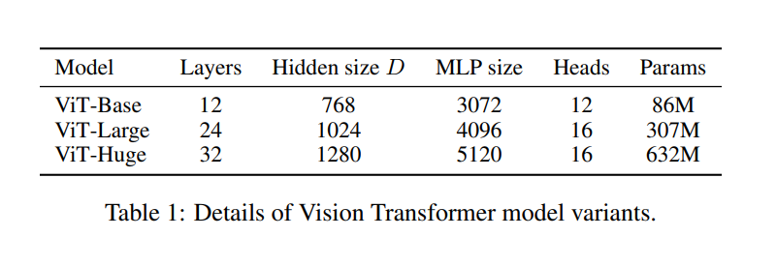
Vision Transformer

Slide 54

B = Base
L = Large
H = Huge
/32, /16, /14 is patch size; smaller patch size is a bigger model (more patches)
BiT – modified Resnet architecture
Imagenet: 1.2M images, 1k classes
ViT models perform worse than ResNets ☹

Slide 55
B = Base
L = Large
H = Huge
/32, /16, /14 is patch size; smaller patch size is a bigger model (more patches)
BiT – modified Resnet architecture
ImageNet-21k: 14M images, 21k categories
pretrain on ImageNet-21k and fine-tune on ImageNet
big ViTs match big ResNets

Slide 56
B = Base
L = Large
H = Huge
/32, /16, /14 is patch size; smaller patch size is a bigger model (more patches)
BiT – modified Resnet architecture
JFT - 300M internal Google dataset with 300M images
pretrain on JFT and fine-tune on ImageNet
large ViTs outperform large ResNets

Slide 57
DeIT
Training data-efficient image transformers & distillation through attention
https://arxiv.org/abs/2012.12877

Slide 58


Knowledge distillation
Step 1: Train a teacher model on images and ground-truth labels (cross entropy loss)
KL divergence loss
(knowledge distillation loss)
You can also use standard CE loss
Step 2: Train a student model to match predictions from the teacher
https://pub.towardsai.net/a-gentle-introduction-to-knowledge-distillation-6240bf8eb8ea

Slide 59

DeIT Data-efficient Image Transformers
Train a teacher CNN on ImageNet
Train a student ViT to match ImageNet predictions from the teacher CNN and match GT labels
https://arxiv.org/abs/2012.12877

Slide 60
DeIT Data-efficient Image Transformers
Predicted class scores; should match labels
Use CE loss
Predicted class scores; should match teacher output
https://arxiv.org/abs/2012.12877

Slide 61


Soft-label vs Hard-label distillation
Softmax with temperature:

Slide 62

DeIT Data-efficient Image Transformers

Slide 63
SwinTransformer: Hierarchical Vision Transformer using Shifted Windows

Slide 64

SWIN Transformer
CNNs – hierarchical architecture
Decrease resolution and increase channels as you go deeper in the network
ViT – isotropic architecture
all blocks have same resolution and number of channels

Slide 65

SWIN Transformer
Divide image into 4x4 patches and project to C dimensions
https://arxiv.org/abs/2103.14030

Slide 66
SWIN Transformer
Divide image into 4x4 patches and project to C dimensions
Merge patches in neigh. 2x2, patches are 8x8
https://arxiv.org/abs/2103.14030

Slide 67



SWIN Transformer
Linear projection (1x1 conv)
“The first patch merging layer concatenates the features of each group of 2×2 neighboring patches, and appliesa linear layer on the 4C-dimensional concatenated features.
This reduces the number of tokens by a multiple of 2×2=4 (2× down sampling of resolution), and the output dimension is set to 2C”
https://arxiv.org/abs/2103.14030

Slide 68
SWIN Transformer
Divide image into 4x4 patches and project to C dimensions
Merge patches in neigh. 2x2, patches are 8x8
Merge patches in neigh. 2x2, patches are 16x16
https://arxiv.org/abs/2103.14030

Slide 69

SWIN Transformer
With H x W grid of tokens, each attention matrix is quadratic in image size H²x W²
Swin transformer computes self-attention locally within M non-overlapping windows that partition an image
Split image into M windows (M=4 in the example)
Only compute attention within each window

Slide 70
SWIN Transformer
With H x W grid of tokens,each attention matrix is quadratic in image size H²x W²
Swin transfromer computes self-attention locally within M non-overlapping windows that partitionan image
Split image into M windows (M=4 in the example)
Only compute attention within each window
Total size of all attention matrices is now: M⁴ (H/M) (W/M) = M² HW
M = 7 in the SWIN transformer paper
Linear in image size for fixed values of M

Slide 71
SWIN Transformer
The window-based self-attention module lacks connections across windows,which limits its modeling power.
No interaction with tokens outside the window
Solution: alternate between normal and shifted in alternative transformer blocks in the architecture

Slide 72

SWIN Transformer
Displacing the windows by [M/2, M/2] pixels from the regularly partitioned window
introduces connections between neighboring non-overlapping windows in the previous layer

Slide 73


SWIN Transformer
Other details
Cyclic shifting and masked attention
Encodes relativepositionbetween patches when computing attention

